Slide 1
Regional Center for Nuclear
Education & Training
Summary - 2020
| www.GoNuke.org

Slide 2
Overview
Who We Are, Goals, & Accomplishments
Notes:
Of course you will not actually write your cover letter. Your letter should typed on your word processor preferably using the same font and ink color as your resume.
Address the letter to an individual if possible, however, if you do not know the name of the individual, you may substitute a name with the appropriate department – usually Human Resources. For a amle individual, use “Mr. (last name), for a woman, use Ms. (lastname) . If you not sure, use To Whom it May Concern:
Reserve the Salutation “Dear” for an actual person. Always use a colon rather than a comma after the salutation.
Don’t forget to date your letter.

Slide 3
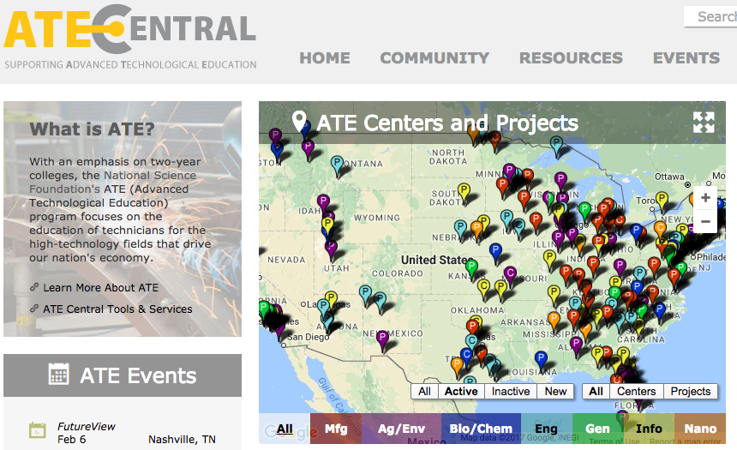
What is ATE?
ATE: Advanced Technological Education
Is a funding Division of the National Science Foundation under the Education Directorate
Receives ~ $65M every year since 1990 to fund community college training
Approximately schools currently funded
Highest level of funding (~10 are centers at $1M/year)

Slide 4
What is RCNET
RCNET is an NSF ATE Center funded since 2008 to focus on nuclear energy technician training
Through 40+ college partnerships across the nation, RCNET graduates ~ 300 A.S. nuclear technicians per year
RCNET in conjunction with NEI and INPO created a portable nuclear energy credential for A.S. technicians called the NUCP (Nuclear Uniform Curriculum Program)
Expanded to Environmental Fields in 2012
Focus on Standardized Curriculum, National Program Sustainability, and Professional Development

Slide 5
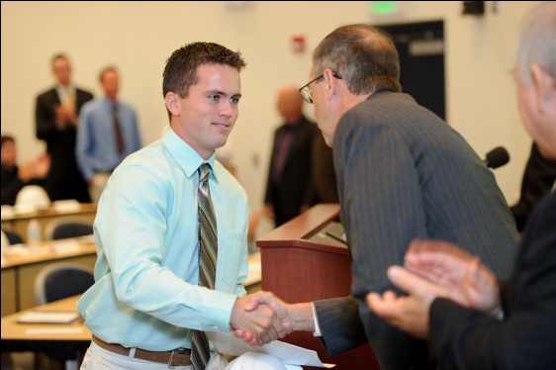
RCNET’s Mission & Goals
Mission
Goals
To make sure the demand for skilled nuclear technicians is met in a standardized and systematic way.
Provide standardized nuclear curriculum packages.
Develop, categorize, and maintain a learning repository for nuclear curriculum.
Provide professional development for educators.
Embed unique training systems and 21st century technologies into the classroom.
Provide career and academic pathways.
Provide career assistance.
Provide materials and assistance in secondary outreach and diversity recruitment.
Promote nuclear careers.
Notes:
Of course you will not actually write your cover letter. Your letter should typed on your word processor preferably using the same font and ink color as your resume.
Address the letter to an individual if possible, however, if you do not know the name of the individual, you may substitute a name with the appropriate department – usually Human Resources. For a amle individual, use “Mr. (last name), for a woman, use Ms. (lastname) . If you not sure, use To Whom it May Concern:
Reserve the Salutation “Dear” for an actual person. Always use a colon rather than a comma after the salutation.
Don’t forget to date your letter.

Slide 6
National Impact
Developed and standardized over 1,200 lectures, 16 classes, 1 biographical textbook, and 8 advanced technology modules.
Graduated over 3,000 students with 90% placement at over 100 industry partners.
Helped 14 colleges launch or expand their nuclear program.
Developed and launched 4 standardized articulation agreements with Excelsior College, FIU, UF, and Bismarck State College. Over 40 graduates continue on to a 4 year degree programs every year!
Developed partnership with United States Navy standardizing credit for veterans at partner colleges.
Developed partnership and funding mechanism with NRC and United Negro College Fund to increase minority ranks in nuclear programs.
Annually, host over 40 outreach events that directly reach 2,000+ students and 470 educators at 231 schools.
Annually, host 10 professional development seminars attended by 20+ colleges and 40+ industry partners to share best practices in nuclear training.

Slide 7
National Impact (cont’d)
Published a book on nuclear mavericks to teach soft skills needed in the nuclear industry.
Developed and replicated a remedial Math Program to increase minority engagement.
Developed curriculum for environmental and deactivation/decommissioning tracks.
Developed a series of silent videos designed to recruit under-served populations.
Expanded International to over 30 countries
Formed partnership with Utah State University NSF Project focused on wastewater training.
Invited to be board member of the American Nuclear Society (ANS) Robotics Division.
Member of ANS, DOE, NSF, and NRC Advisory Boards

Slide 8
Details of IRSC’s Program
Formally established in 2006 an FPL partnership (St. Lucie Nuclear Generation Station).
Informally, IRSC has trained FPL employees for greater than 30 years.
SACS Accredited 2-year A.S. Program.
1st Certified NUCP College.
Certified to offer mechanical, electrical, instrument and controls, radiation protection, and chemistry technician tracks.
Program articulates to 4 year degree programs at Excelsior College, Thomas Edison State College, Florida International University, and University of Florida.
Program has 0 full time faculty and 8 SMEs with experience in the field.
Program mapped to ACAD 08-006 standards.
IRSC has been benchmarked by and helped 8 schools and 4 countries establish programs.

Slide 9
Program Accomplishments
95% Graduation and 95% Placement Rates
$55,000 Average Annual Starting Salary for graduates
4 industry recognized certificates (OSHA, MSSC, NanTEL, and NUCP)
Degree articulates to FIU, UF, and Excelsior College.
312 graduates since 2006 (176 FPL, 100 BHI/Bartlett, + 36 Other)
163 NUCP certificates awarded (most of any program in nation)
$100,000 = Reported Earnings after Outages
IRSC graduates received jobs at Savannah River Nuclear Labs, Duke Energy, Exelon, Oak Ridge National Labs, GE, Westinghouse, FPL, and Southern Company
ECONOMIC IMPACT IN THE COMMUNITY:
312 jobs at $55,000/year = $17,160,000/year
Multiplier of 2 = $34,320,000 /year
900 additional support jobs.
>$14M in grants ($9.5M NSF; $2M DOE; $1.5M NRC)

Slide 10
IRSC Accolades & Support

Slide 11
COVID-19 Response
Notes:
Of course you will not actually write your cover letter. Your letter should typed on your word processor preferably using the same font and ink color as your resume.
Address the letter to an individual if possible, however, if you do not know the name of the individual, you may substitute a name with the appropriate department – usually Human Resources. For a amle individual, use “Mr. (last name), for a woman, use Ms. (lastname) . If you not sure, use To Whom it May Concern:
Reserve the Salutation “Dear” for an actual person. Always use a colon rather than a comma after the salutation.
Don’t forget to date your letter.

Slide 12
Common Program Details – Pre COVID-19
Enrollment was ~ 24 - 48 FT students per school
80% in-person
~ 50% Hands on & 50% Lecture
Embedded Industry Certifications
Summer Internships
Direct Outreach & Recruiting
Notes:
Of course you will not actually write your cover letter. Your letter should typed on your word processor preferably using the same font and ink color as your resume.
Address the letter to an individual if possible, however, if you do not know the name of the individual, you may substitute a name with the appropriate department – usually Human Resources. For a amle individual, use “Mr. (last name), for a woman, use Ms. (lastname) . If you not sure, use To Whom it May Concern:
Reserve the Salutation “Dear” for an actual person. Always use a colon rather than a comma after the salutation.
Don’t forget to date your letter.

Slide 13
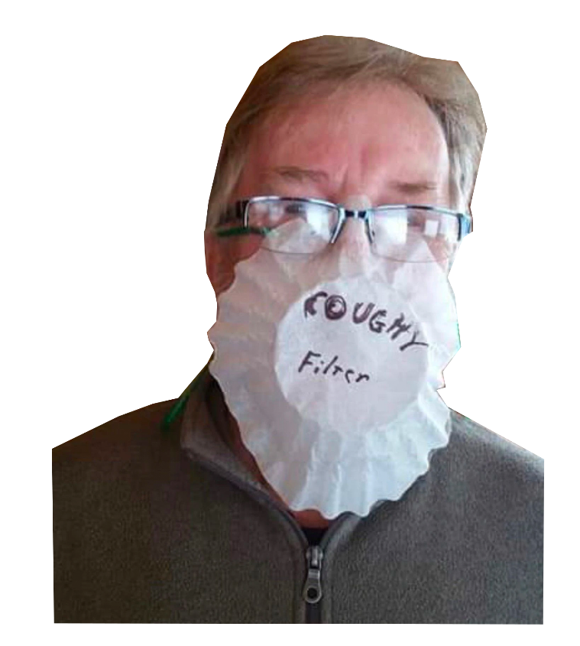
Available Resources Thanks to ATE/ATE Culture
Network
Tons of Online Resources
Dynamic Personnel
Dynamic Budgets
Notes:
Of course you will not actually write your cover letter. Your letter should typed on your word processor preferably using the same font and ink color as your resume.
Address the letter to an individual if possible, however, if you do not know the name of the individual, you may substitute a name with the appropriate department – usually Human Resources. For a amle individual, use “Mr. (last name), for a woman, use Ms. (lastname) . If you not sure, use To Whom it May Concern:
Reserve the Salutation “Dear” for an actual person. Always use a colon rather than a comma after the salutation.
Don’t forget to date your letter.

Slide 14
COVID Support Needed
Curriculum
Continuity of Operations
Marketing & Outreach
Notes:
Of course you will not actually write your cover letter. Your letter should typed on your word processor preferably using the same font and ink color as your resume.
Address the letter to an individual if possible, however, if you do not know the name of the individual, you may substitute a name with the appropriate department – usually Human Resources. For a amle individual, use “Mr. (last name), for a woman, use Ms. (lastname) . If you not sure, use To Whom it May Concern:
Reserve the Salutation “Dear” for an actual person. Always use a colon rather than a comma after the salutation.
Don’t forget to date your letter.

Slide 15
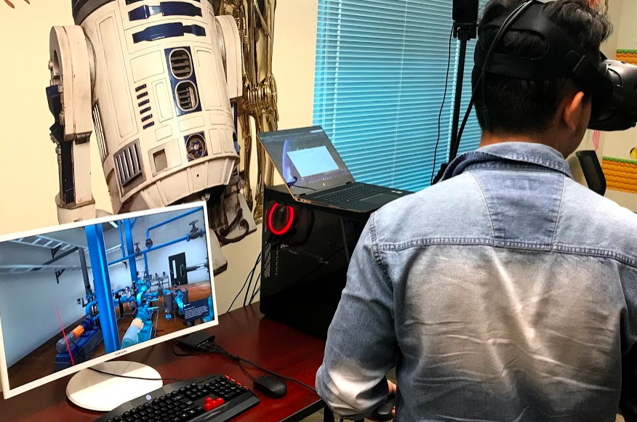
RCNET Curriculum Solutions and Support
18 Courses segmented into course leaning outcomes modules (or cartridges)
Full Environmental Management A.S. Degree
Built to Quality Matter Specifications for Blackboard.
VR resources with hands on activities matching key industry training events
Tagging and Start Up Procedure
Maintenance Procedure
Event Response
Notes:
Of course you will not actually write your cover letter. Your letter should typed on your word processor preferably using the same font and ink color as your resume.
Address the letter to an individual if possible, however, if you do not know the name of the individual, you may substitute a name with the appropriate department – usually Human Resources. For a amle individual, use “Mr. (last name), for a woman, use Ms. (lastname) . If you not sure, use To Whom it May Concern:
Reserve the Salutation “Dear” for an actual person. Always use a colon rather than a comma after the salutation.
Don’t forget to date your letter.

Slide 16
RCNET Continuity of Operations Support
Scheduling Advice
Operating Procedures
The overall class is ~ 20 students broken into two 10 person blocks for staggered live training
~70% of fundamental material online done as a whole class of 20 students
~ 30% in person which equates to 1 live lab, lecture, group project every 2 weeks. This portion is staggered into two groups of ten and repeated by the faculty twice ~ once every 2 weeks.
The faculty receives 4 credits instead of 3 because they are doing ~ 30% more work (i.e. repeating the 30% two times)
Notes:
Of course you will not actually write your cover letter. Your letter should typed on your word processor preferably using the same font and ink color as your resume.
Address the letter to an individual if possible, however, if you do not know the name of the individual, you may substitute a name with the appropriate department – usually Human Resources. For a amle individual, use “Mr. (last name), for a woman, use Ms. (lastname) . If you not sure, use To Whom it May Concern:
Reserve the Salutation “Dear” for an actual person. Always use a colon rather than a comma after the salutation.
Don’t forget to date your letter.

Slide 17
RCNET Marketing & Outreach
Academia went Online (K-12)
Academia had trouble filling a daily agenda
Notes:
Of course you will not actually write your cover letter. Your letter should typed on your word processor preferably using the same font and ink color as your resume.
Address the letter to an individual if possible, however, if you do not know the name of the individual, you may substitute a name with the appropriate department – usually Human Resources. For a amle individual, use “Mr. (last name), for a woman, use Ms. (lastname) . If you not sure, use To Whom it May Concern:
Reserve the Salutation “Dear” for an actual person. Always use a colon rather than a comma after the salutation.
Don’t forget to date your letter.

Slide 18
Data
Student and Partnership
Notes:
Of course you will not actually write your cover letter. Your letter should typed on your word processor preferably using the same font and ink color as your resume.
Address the letter to an individual if possible, however, if you do not know the name of the individual, you may substitute a name with the appropriate department – usually Human Resources. For a amle individual, use “Mr. (last name), for a woman, use Ms. (lastname) . If you not sure, use To Whom it May Concern:
Reserve the Salutation “Dear” for an actual person. Always use a colon rather than a comma after the salutation.
Don’t forget to date your letter.

Slide 19
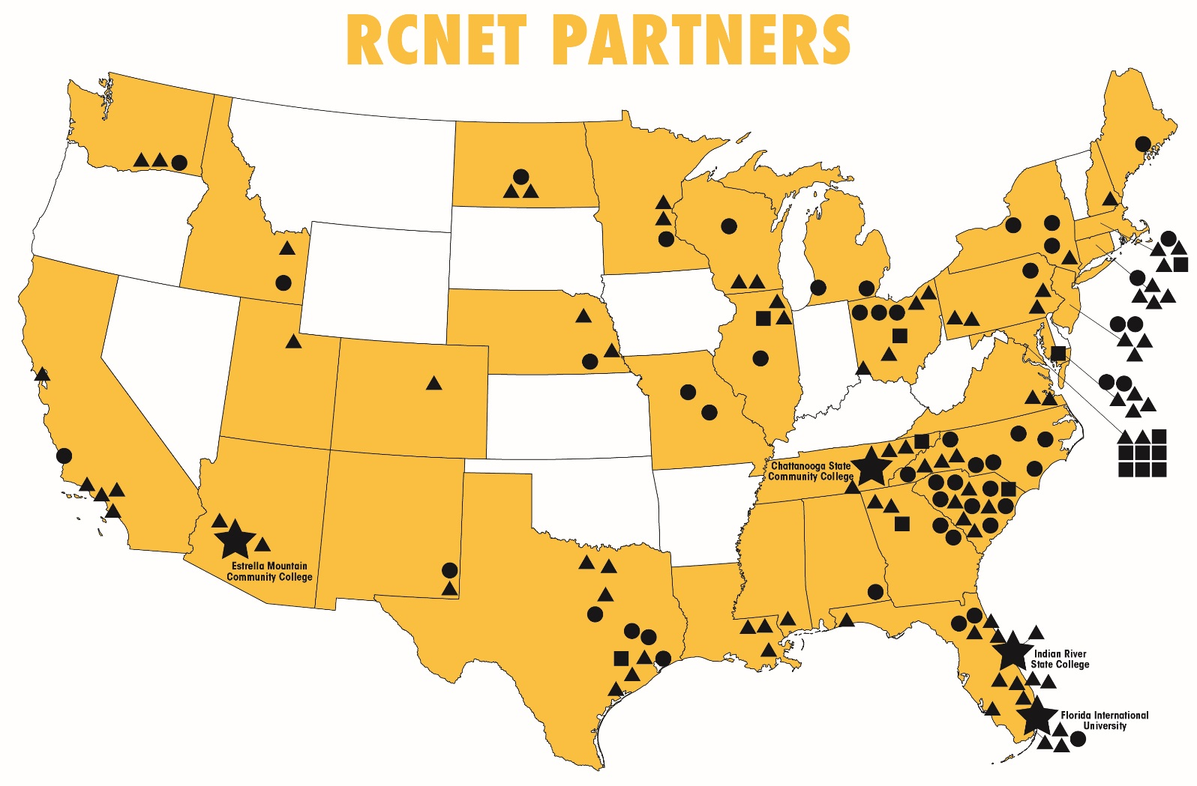
RCNET Partners
RCNET is headquartered at Indian River State College in Fort Pierce, FL and is a consortium of of 100 industry, 55 academic, and 15 agency partnerships across the United States and 7 countries.
Notes:
Of course you will not actually write your cover letter. Your letter should typed on your word processor preferably using the same font and ink color as your resume.
Address the letter to an individual if possible, however, if you do not know the name of the individual, you may substitute a name with the appropriate department – usually Human Resources. For a amle individual, use “Mr. (last name), for a woman, use Ms. (lastname) . If you not sure, use To Whom it May Concern:
Reserve the Salutation “Dear” for an actual person. Always use a colon rather than a comma after the salutation.
Don’t forget to date your letter.

Slide 20
RCNET Student Enrollment
Primarily Nuclear
Energy Technicians
80% Nuclear Energy;
20% Nuclear Environmental
50% Nuclear Energy;
50% Nuclear Environmental
Notes:
Of course you will not actually write your cover letter. Your letter should typed on your word processor preferably using the same font and ink color as your resume.
Address the letter to an individual if possible, however, if you do not know the name of the individual, you may substitute a name with the appropriate department – usually Human Resources. For a amle individual, use “Mr. (last name), for a woman, use Ms. (lastname) . If you not sure, use To Whom it May Concern:
Reserve the Salutation “Dear” for an actual person. Always use a colon rather than a comma after the salutation.
Don’t forget to date your letter.

Slide 21
RCNET College Programs
Primarily Nuclear
Energy Technicians
80% Nuclear Energy;
20% Nuclear Environmental
50% Nuclear Energy;
50% Nuclear Environmental
Notes:
Of course you will not actually write your cover letter. Your letter should typed on your word processor preferably using the same font and ink color as your resume.
Address the letter to an individual if possible, however, if you do not know the name of the individual, you may substitute a name with the appropriate department – usually Human Resources. For a amle individual, use “Mr. (last name), for a woman, use Ms. (lastname) . If you not sure, use To Whom it May Concern:
Reserve the Salutation “Dear” for an actual person. Always use a colon rather than a comma after the salutation.
Don’t forget to date your letter.

Slide 22
RCNET Student Demographics
Notes:
Of course you will not actually write your cover letter. Your letter should typed on your word processor preferably using the same font and ink color as your resume.
Address the letter to an individual if possible, however, if you do not know the name of the individual, you may substitute a name with the appropriate department – usually Human Resources. For a amle individual, use “Mr. (last name), for a woman, use Ms. (lastname) . If you not sure, use To Whom it May Concern:
Reserve the Salutation “Dear” for an actual person. Always use a colon rather than a comma after the salutation.
Don’t forget to date your letter.

Slide 23
RCNET Best Practices
Notes:
Of course you will not actually write your cover letter. Your letter should typed on your word processor preferably using the same font and ink color as your resume.
Address the letter to an individual if possible, however, if you do not know the name of the individual, you may substitute a name with the appropriate department – usually Human Resources. For a amle individual, use “Mr. (last name), for a woman, use Ms. (lastname) . If you not sure, use To Whom it May Concern:
Reserve the Salutation “Dear” for an actual person. Always use a colon rather than a comma after the salutation.
Don’t forget to date your letter.

Slide 24
Amazing New Website
Notes:
Of course you will not actually write your cover letter. Your letter should typed on your word processor preferably using the same font and ink color as your resume.
Address the letter to an individual if possible, however, if you do not know the name of the individual, you may substitute a name with the appropriate department – usually Human Resources. For a amle individual, use “Mr. (last name), for a woman, use Ms. (lastname) . If you not sure, use To Whom it May Concern:
Reserve the Salutation “Dear” for an actual person. Always use a colon rather than a comma after the salutation.
Don’t forget to date your letter.

Slide 25
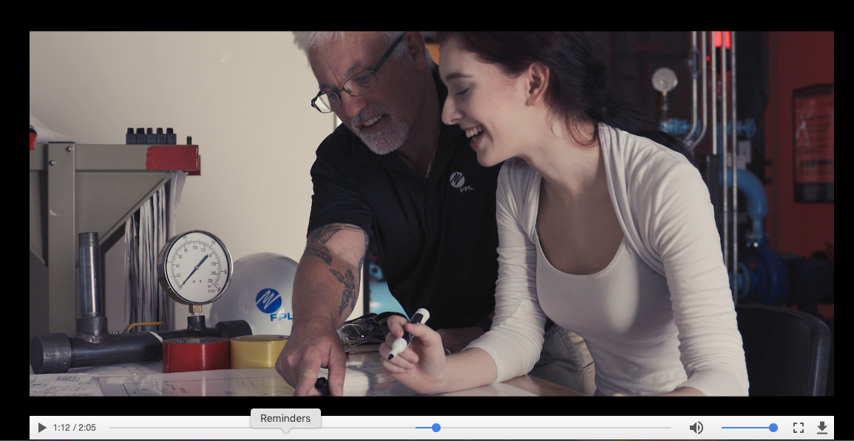
Customized Marketing Material
Viral video promoted by White House with custom beginning and end options
https://www.youtube.com/watch?v=4QH-D4_FK18&t=28s

Slide 26
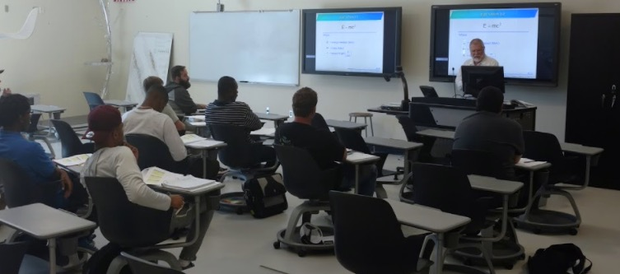
Best Practices on Math and Minority Engagement
Implemented at 14 colleges and institutionalized at 2 colleges
Increased national minority Involvement by ~6%
Featured in Diverse Magazine, National Academy of Science, and by ASPEN Foundation

Slide 27
Helping Programs Stay Open
Partnered and worked out administrative details (like financial aid, accreditation, transfer) with online options at TESC, Bismarck State College, and IRSC

Slide 28
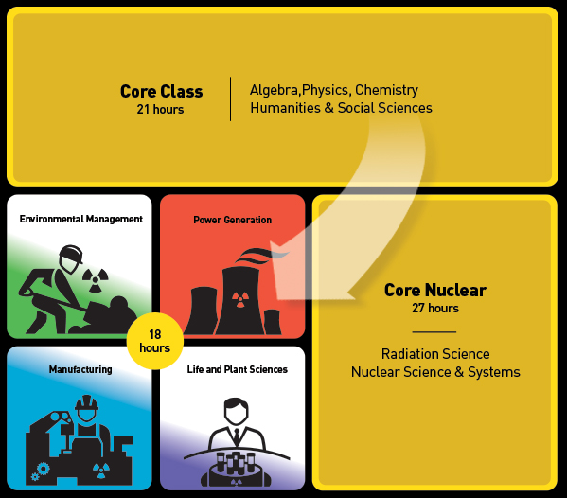
Tons of Curriculum for Nuclear Energy and Environmental Programs
Cohort
Guided Pathway
Common 1st year
Embedded Internship
Embedded Certifications

Slide 29
Established Standardized Curriculum with Industry Recognized Certificate
In 2011, recognizing the immediate need for a large replacement nuclear workforce, RCNET worked with industry and nuclear agencies to create a nuclear unified curriculum program. This credential awarded to colleges by INPO verifies that a credentialed college teaches their program to the nuclear standards (ACAD 08-006) and has aligned with local industry.
Students graduating from credentialed colleges and having achieved an 80% or higher in all key courses are awarded an industry-recognized portable certificate.
Since 2011, RCNET has helped over 20 colleges obtain this certification resulting in over 1,5000 NUCP certificates awarded to nuclear technician graduates.
Additionally, RCNET has developed a host of curriculum resources mapped to the over 1,200 NUCP learning objectives which can be found below.
Notes:
Of course you will not actually write your cover letter. Your letter should typed on your word processor preferably using the same font and ink color as your resume.
Address the letter to an individual if possible, however, if you do not know the name of the individual, you may substitute a name with the appropriate department – usually Human Resources. For a amle individual, use “Mr. (last name), for a woman, use Ms. (lastname) . If you not sure, use To Whom it May Concern:
Reserve the Salutation “Dear” for an actual person. Always use a colon rather than a comma after the salutation.
Don’t forget to date your letter.

Slide 30
Established Standardized Curriculum with Industry Recognized Certificate
Notes:
Of course you will not actually write your cover letter. Your letter should typed on your word processor preferably using the same font and ink color as your resume.
Address the letter to an individual if possible, however, if you do not know the name of the individual, you may substitute a name with the appropriate department – usually Human Resources. For a amle individual, use “Mr. (last name), for a woman, use Ms. (lastname) . If you not sure, use To Whom it May Concern:
Reserve the Salutation “Dear” for an actual person. Always use a colon rather than a comma after the salutation.
Don’t forget to date your letter.

Slide 31
Other Curriculum Details
Notes:
Of course you will not actually write your cover letter. Your letter should typed on your word processor preferably using the same font and ink color as your resume.
Address the letter to an individual if possible, however, if you do not know the name of the individual, you may substitute a name with the appropriate department – usually Human Resources. For a amle individual, use “Mr. (last name), for a woman, use Ms. (lastname) . If you not sure, use To Whom it May Concern:
Reserve the Salutation “Dear” for an actual person. Always use a colon rather than a comma after the salutation.
Don’t forget to date your letter.

Slide 32
Curriculum Details
30 classes fully developed covering QA/QC, Instrument and Controls, Mechanical, Electrical, and Radiation/Chemistry Protection.
Over 1200 lectures matched to PLOs and ACADs (lectures include PowerPoint’s, teaching guides, assessment material, and PLOs and ACADs covered)
7 modules (60-180 minutes) covering emerging technologies such as 3D printing, robotics, cyber security, and sensors in a nuclear environment.
Online Introduction to Nuclear Course
Copyright licenses to commercial products available for distribution
1 Textbook – Nuclear Mavericks
10 courses under development for EM and Life/Plant Sciences
Notes:
Of course you will not actually write your cover letter. Your letter should typed on your word processor preferably using the same font and ink color as your resume.
Address the letter to an individual if possible, however, if you do not know the name of the individual, you may substitute a name with the appropriate department – usually Human Resources. For a amle individual, use “Mr. (last name), for a woman, use Ms. (lastname) . If you not sure, use To Whom it May Concern:
Reserve the Salutation “Dear” for an actual person. Always use a colon rather than a comma after the salutation.
Don’t forget to date your letter.

Slide 33
Curriculum Utilization
Type of Material | Secondary Education |  |  | Post- Secondary Attendance
 | # Student | # Educators | # Schools | # Student | # Educators | # Schools
Nuclear Mavericks: RCNET Developed Bibliographic Textbook on Nuclear Pioneers |  |  |  | 528 | 22 | 22
Utilizing RCNET Curriculum Materials | 160 | 4 | 4 | 1344 |  | 28
Curriculum on lessons learned at Fukushima. |  |  |  | 120 | 5 | 5
Curriculum on advanced technology (3D Scanning and Printing, Robotics, and Cyber Security) |  |  |  | 288 | 12 | 12
Introduction to Nuclear E-Learning Course | 600 | 70 | 70
Notes:
Of course you will not actually write your cover letter. Your letter should typed on your word processor preferably using the same font and ink color as your resume.
Address the letter to an individual if possible, however, if you do not know the name of the individual, you may substitute a name with the appropriate department – usually Human Resources. For a amle individual, use “Mr. (last name), for a woman, use Ms. (lastname) . If you not sure, use To Whom it May Concern:
Reserve the Salutation “Dear” for an actual person. Always use a colon rather than a comma after the salutation.
Don’t forget to date your letter.

Slide 34
Environmental Management Courses
Summer
Internship
DOE Partnership
Second Year Classes
(15 Credit Hours)
Class 1: Introduction to Environmental Regulations
Cass 2: Nuclear Materials Processing
Class 3: Deactivating & Decommissioning Strategies
Class 4: Radioactive Waste Management
Class 5: Capstone / Special Project
Notes:
Of course you will not actually write your cover letter. Your letter should typed on your word processor preferably using the same font and ink color as your resume.
Address the letter to an individual if possible, however, if you do not know the name of the individual, you may substitute a name with the appropriate department – usually Human Resources. For a amle individual, use “Mr. (last name), for a woman, use Ms. (lastname) . If you not sure, use To Whom it May Concern:
Reserve the Salutation “Dear” for an actual person. Always use a colon rather than a comma after the salutation.
Don’t forget to date your letter.

Slide 35
Environmental Management Courses
Introduction to Environmental Regulations
Federal/State Laws & Regulations
Chemical Processes
Waste Tank
Transportation & Shipping
Radioactive Waste Management
OSHA
EPA
NRC
HAZMAT
Labs/Activities
Case Studies (Presentation & Discussion Forums)
Gasification
Systems & Processes
Labs / Activities (Site Visits, Tours, Simulations)
Decontamination
Deactivation
Site Inspection & Monitoring
Demolition Techniques
Project Management
Waste Monitoring
Labs / Activities
Waste Character
Toxicology
Geology
Hydrology
Nuclear Safety
Risk Management
Waste Handling
Site Monitoring
Labs / Activities
Capstone / Special Project
New Technologies (Robotics, 3D Printing, Etc.)
Case Study
Soft Skills
Team Work
Labs / Activities
Nuclear Materials Processing
Deactivating & Decommissioning Strategies
Class One
Class Two
Class Three
Class Four
Class Five
Notes:
Of course you will not actually write your cover letter. Your letter should typed on your word processor preferably using the same font and ink color as your resume.
Address the letter to an individual if possible, however, if you do not know the name of the individual, you may substitute a name with the appropriate department – usually Human Resources. For a amle individual, use “Mr. (last name), for a woman, use Ms. (lastname) . If you not sure, use To Whom it May Concern:
Reserve the Salutation “Dear” for an actual person. Always use a colon rather than a comma after the salutation.
Don’t forget to date your letter.

Slide 36
RCNET Modules
Complete Lesson Plan
Power Point Presentation
Pre & Post Assessments
Supplement Materials
Takeaways
Objectives
Topics
Hands On Activities
Notes:
Topic
Overview
Learning Objectives
ACADs
Topic & Takeaways for each section
Teacher Lecture Notes
PPT
Pre & Post Assessment
Supplement & Enrichment Materials

Slide 37
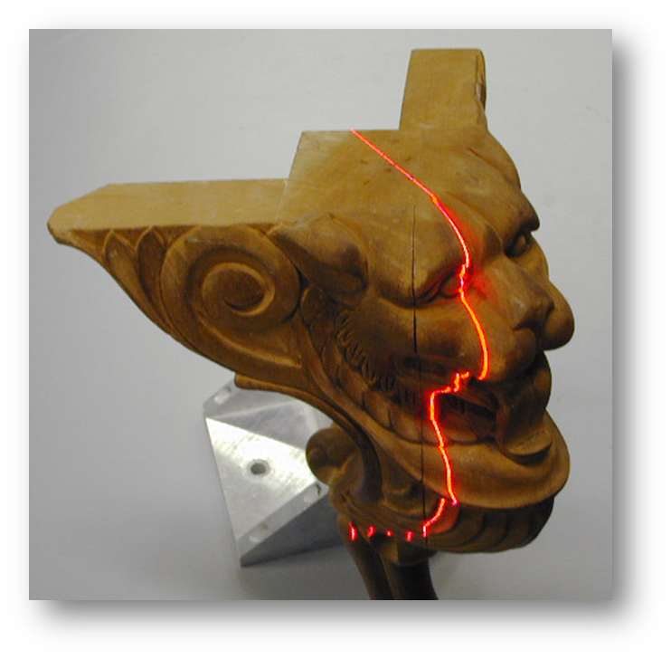
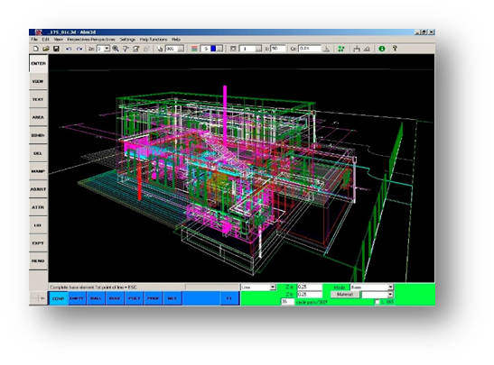
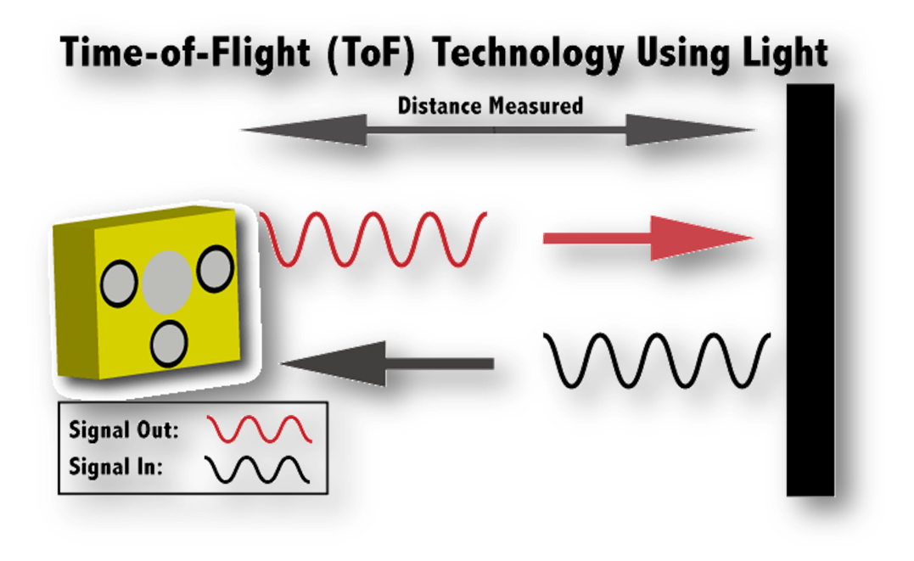
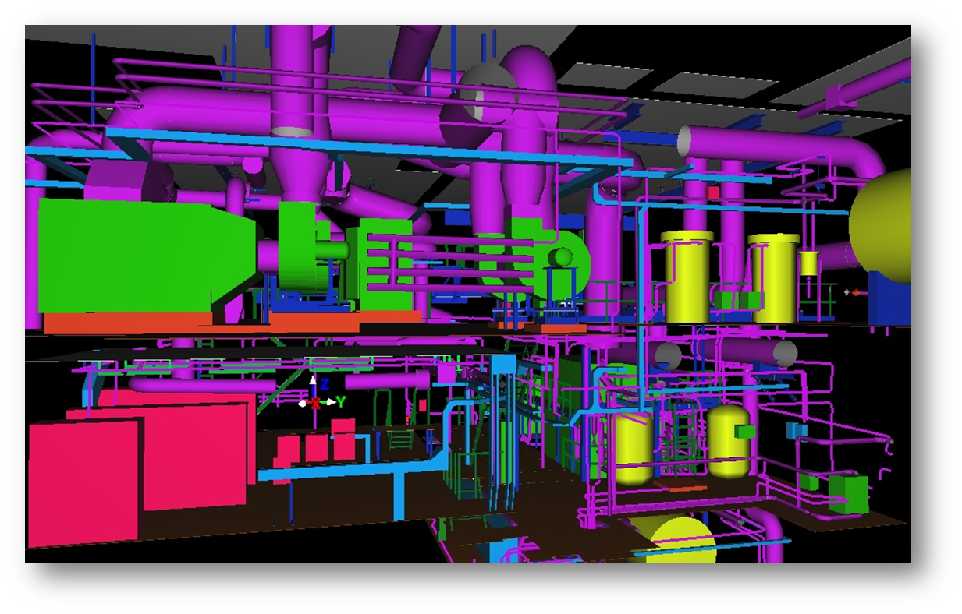
RCNET Module: Nuclear 3D Scanning
Learning Objectives
Describe the basics components of a 3D scanner.
Identify the types of 3D scanning technology most often used in the nuclear industry.
Discuss the applications and limitations of 3D scanning as they pertain to the nuclear industry.
Identify and discuss the different types of software, inputs and outputs used for 3D scanning.
Recognize and discuss opportunities where 3D Scanning technologies would be applicable in a nuclear environment.
Notes:
Of course you will not actually write your cover letter. Your letter should typed on your word processor preferably using the same font and ink color as your resume.
Address the letter to an individual if possible, however, if you do not know the name of the individual, you may substitute a name with the appropriate department – usually Human Resources. For a amle individual, use “Mr. (last name), for a woman, use Ms. (lastname) . If you not sure, use To Whom it May Concern:
Reserve the Salutation “Dear” for an actual person. Always use a colon rather than a comma after the salutation.
Don’t forget to date your letter.

Slide 38
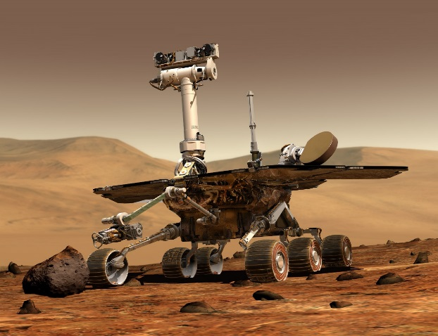
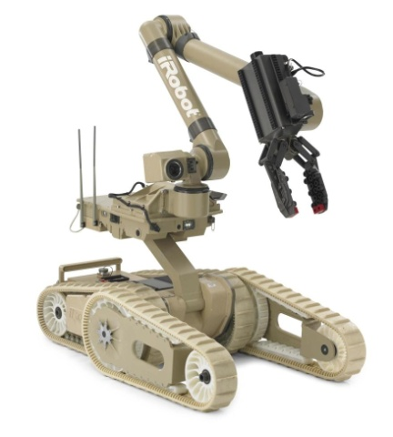
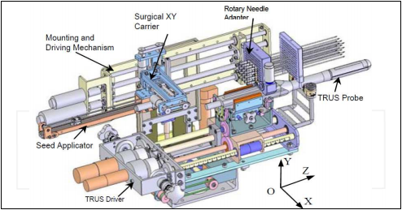
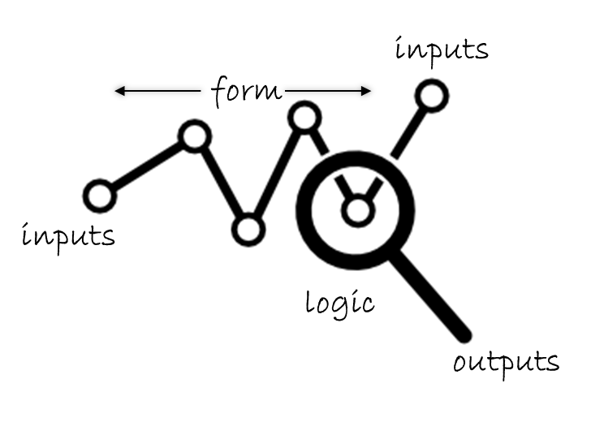
RCNET Module: Nuclear Robotics
Learning Objectives
Identify what constitutes a robot
Identify Nuclear Applications of Robotics, both current and future
Enumerate and describe the basic methods of robot control
Identify and discuss functions and limitations of nuclear robotic systems
Describe the basics of the Robot Operating System
Define open/closed loop control and degrees of freedom
Notes:
Of course you will not actually write your cover letter. Your letter should typed on your word processor preferably using the same font and ink color as your resume.
Address the letter to an individual if possible, however, if you do not know the name of the individual, you may substitute a name with the appropriate department – usually Human Resources. For a amle individual, use “Mr. (last name), for a woman, use Ms. (lastname) . If you not sure, use To Whom it May Concern:
Reserve the Salutation “Dear” for an actual person. Always use a colon rather than a comma after the salutation.
Don’t forget to date your letter.

Slide 39
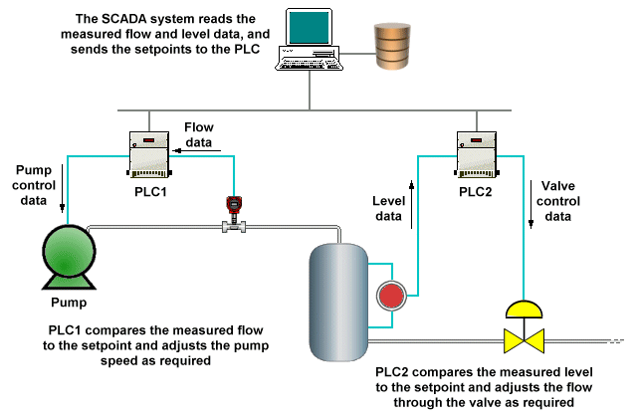
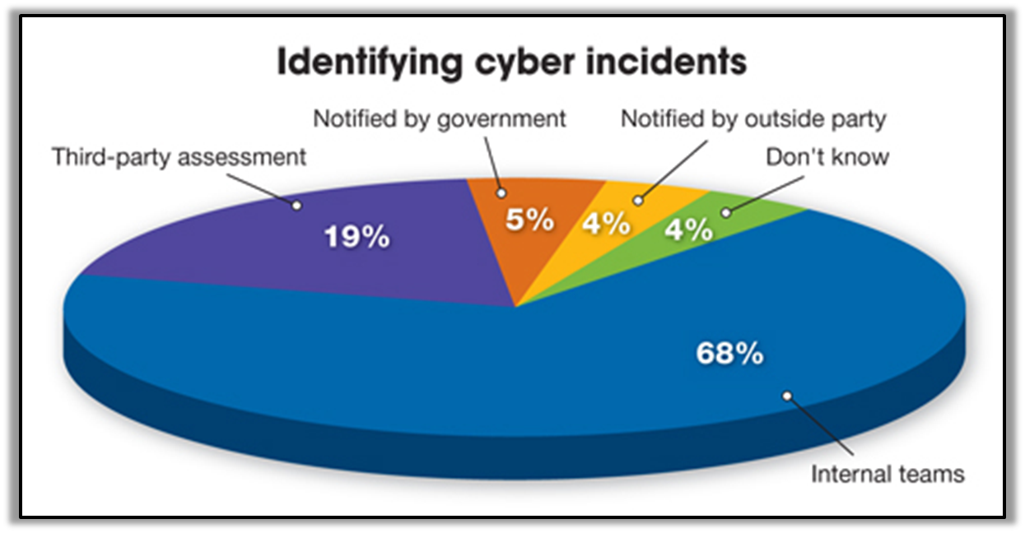
RCNET Module: Nuclear Cyber Security
Learning Objectives
Develop and reinforce a common language and understanding of Industrial Control System (ICS)
Demonstrate the necessary cyber-to-physical knowledge to better understand the importance of ICS operational drivers and constraints that require specific safety protection, communications needs, system management approaches, and cybersecurity implementations.
Know the adversary's approaches to attacking an ICS SCADA environment to be better prepared to defend that environment.
Develop a better understanding of where specific attack vectors exist, as well as the tools to use to discover vulnerabilities and exploit them along with specific capabilities available on servers, workstations, and applications, students will now learn network-specific defense approaches.
Better understand attacks targeting the types of web servers used on many ICS devices for management purposes.
Discuss essential ICS-related server and workstation operating system capabilities, implementation approaches, and system management practices.
Examine concepts that benefit SCADA ICS systems such as system hardening, log management, monitoring, alerting, and audit approaches, then look at some of the more common applications and databases used in ICS environments across multiple industries.
Implement technologies used to defend ICS networks.
Discuss the various models, methodologies, and industry-specific regulations that are used to govern what must be done to protect critical SCADA ICS systems.
Notes:
Of course you will not actually write your cover letter. Your letter should typed on your word processor preferably using the same font and ink color as your resume.
Address the letter to an individual if possible, however, if you do not know the name of the individual, you may substitute a name with the appropriate department – usually Human Resources. For a amle individual, use “Mr. (last name), for a woman, use Ms. (lastname) . If you not sure, use To Whom it May Concern:
Reserve the Salutation “Dear” for an actual person. Always use a colon rather than a comma after the salutation.
Don’t forget to date your letter.

Slide 40
Nuclear
Mavericks
RCNET STEM Textbook
Notes:
Students will become familiar with and have a better understanding of pride and ownership in a STEM field and be able to apply lesson learned and takeaways to their own training.

Slide 41
Nuclear Mavericks
describes the trials and tribulations of 9
nuclear pioneers but
can be used in all
STEM introductory
courses to impart a
sense of historical
pride and ownership.
To order books for your school, visit GoNuke.org

Slide 42
Other RCNET Products
Notes:
Of course you will not actually write your cover letter. Your letter should typed on your word processor preferably using the same font and ink color as your resume.
Address the letter to an individual if possible, however, if you do not know the name of the individual, you may substitute a name with the appropriate department – usually Human Resources. For a amle individual, use “Mr. (last name), for a woman, use Ms. (lastname) . If you not sure, use To Whom it May Concern:
Reserve the Salutation “Dear” for an actual person. Always use a colon rather than a comma after the salutation.
Don’t forget to date your letter.

Slide 43
Summary of Other RCNET Products
Product(s) | Audience | Type & Location of Materials
Standardized academic articulation with excelsior college | NUCP graduating students | File transfer guides, contact information, standardized tuition rates and other information available at gonuke.org.
DVD/video on career assistance | NUCP students | Soft skills needed to obtain and grow a nuclear career are detailed. Information on resume writing, interview skills, academic articulation, and RCNET job board are explained.
DVD/video on human development | NUCP college faculty | Best practices at colleges to ready students for work in a nuclear environment will be reviewed. Methods to embed a culture of safety, responsibility, communication, leadership, and articulation are examined and reviewed. Video on gonuke.org and available directly from RCNET.
Biography on Nuclear Pioneers | Students and Technicians | To impart a sense of ownership, RCNET has teamed with 9 technician founders/leaders in the fields of nuclear energy, medicine, weapons, space exploration, and clean up to publish a collection of biographies with a goal of relating the experiences, blood, sweat and tears these pioneers underwent to build the industry.
Notes:
Of course you will not actually write your cover letter. Your letter should typed on your word processor preferably using the same font and ink color as your resume.
Address the letter to an individual if possible, however, if you do not know the name of the individual, you may substitute a name with the appropriate department – usually Human Resources. For a amle individual, use “Mr. (last name), for a woman, use Ms. (lastname) . If you not sure, use To Whom it May Concern:
Reserve the Salutation “Dear” for an actual person. Always use a colon rather than a comma after the salutation.
Don’t forget to date your letter.

Slide 44
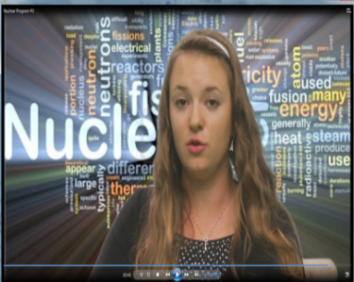
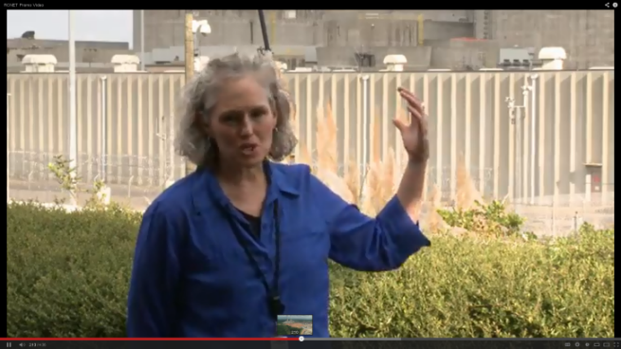
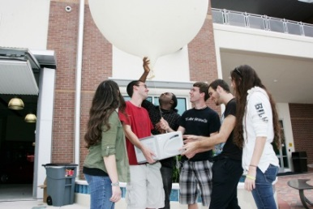
Summary of Other RCNET Products
Product(s) | Target Audience | Type & Location of Materials
Marketing & outreach materials | Academic and industry outreach specialists | RCNET and partner’s marketing material including videos, brochures, fact sheets, images, and other printed material available at gonuke.org.
Job bank | NUCP graduating students & hiring managers | At gonuke.org website. NUCP graduating students can load their resume and hiring managers can sort and search through them on the protected site.
Academic & career flowcharts | NUCP students | Flow charts on career and academic pathways are available on the gonuke.org website
Notes:
Of course you will not actually write your cover letter. Your letter should typed on your word processor preferably using the same font and ink color as your resume.
Address the letter to an individual if possible, however, if you do not know the name of the individual, you may substitute a name with the appropriate department – usually Human Resources. For a amle individual, use “Mr. (last name), for a woman, use Ms. (lastname) . If you not sure, use To Whom it May Concern:
Reserve the Salutation “Dear” for an actual person. Always use a colon rather than a comma after the salutation.
Don’t forget to date your letter.

Slide 45
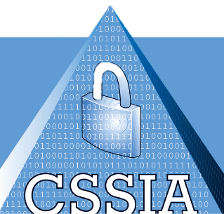
Cross Training Nuclear Programs
RCNET partnered with Weld-Ed, Laser-TEC, FLATE, and CSSIA to expand the resources available to RCNET Industry Partners.
Each center presented their resources at RCNET PD events explaining how their resources could be incorporated into nuclear classroom to give the nuclear student more breadth.
Over and over people commented they didn’t realize this existed.
Notes:
Of course you will not actually write your cover letter. Your letter should typed on your word processor preferably using the same font and ink color as your resume.
Address the letter to an individual if possible, however, if you do not know the name of the individual, you may substitute a name with the appropriate department – usually Human Resources. For a amle individual, use “Mr. (last name), for a woman, use Ms. (lastname) . If you not sure, use To Whom it May Concern:
Reserve the Salutation “Dear” for an actual person. Always use a colon rather than a comma after the salutation.
Don’t forget to date your letter.

Slide 46
WWW.GONUKE.ORG

Slide 47
Thank You
Kevin Cooper
PI, RCNET
kcooper@irsc.edu
Notes:
Of course you will not actually write your cover letter. Your letter should typed on your word processor preferably using the same font and ink color as your resume.
Address the letter to an individual if possible, however, if you do not know the name of the individual, you may substitute a name with the appropriate department – usually Human Resources. For a amle individual, use “Mr. (last name), for a woman, use Ms. (lastname) . If you not sure, use To Whom it May Concern:
Reserve the Salutation “Dear” for an actual person. Always use a colon rather than a comma after the salutation.
Don’t forget to date your letter.

